Slide 1

AI

Slide 2
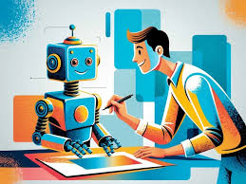
Advantages of AI
Efficiency – AI can work faster and handle large amounts of data.
Accuracy – AI reduces human errors in tasks like calculations and analysis.
Automation – AI can perform repetitive tasks, saving time and effort.

Slide 3

24/7 Availability – AI doesn’t need breaks and can work nonstop.
Personalization – AI tailors recommendations in apps, websites, and services.

Slide 4

Disadvantages of AI
Job Loss – AI can replace human workers in some industries.
High Cost – Developing and maintaining AI is expensive.
Lack of Creativity – AI follows patterns but doesn’t think like humans.

Slide 5
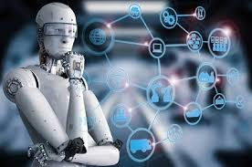
Dependence on Data – AI needs lots of data to function well.
Ethical Concerns – AI can be misused for surveillance or biased decision-making.

Slide 6

Challenges of AI
Bias in AI – AI can inherit unfair biases from its training data.
Security Risks – AI systems can be hacked or misused.
Regulation Issues – Laws on AI use are still developing.

Slide 7
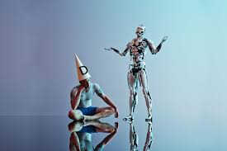
Understanding AI – Many people don’t fully understand how AI makes decisions.
Energy Consumption – AI needs a lot of computing power, which can impact the environment.

